Slide 1
Decision Tree Tutorial
SYDE 422
Week3
23 January 2013

Slide 2
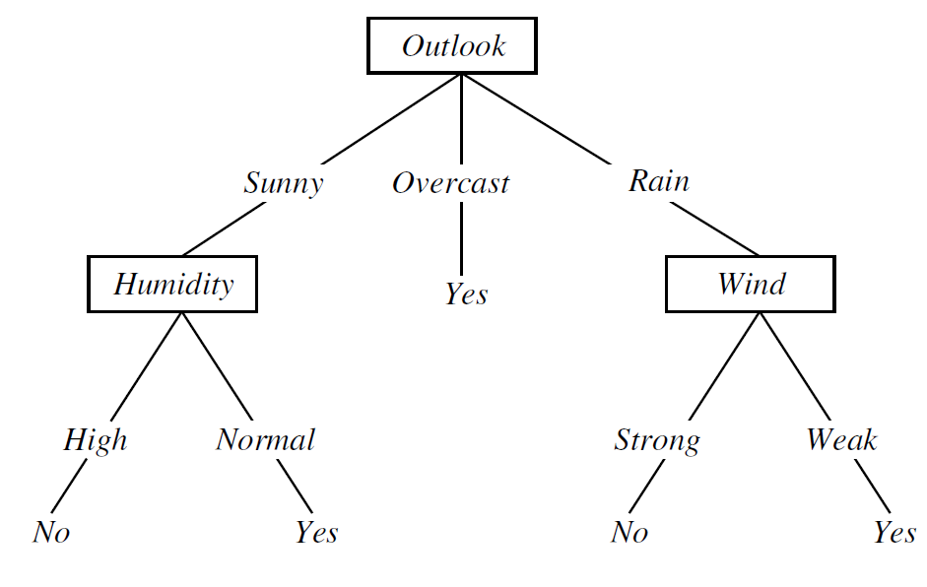
Decision Tree (DT) Overview
How to induce a DT?
Finding a small tree consistent with the training examples
Recursively choosing the most informative attribute as root of the (sub)tree.
[Mitchell and Hill 1997]

Slide 3
Iris Dataset
Associated Task | Classification | #Attributes | 4
#Classes | 3 | #instances | 150
Best known dataset in pattern recognition literature
Attributes
Sepal Length, Sepal Width, Petal Length, and Petal Width
Classes
Iris Setosa, Iris Versicolour, Iris Virginica

Slide 4
Iris Dataset Cont.
Sepal Length | Sepal Width | Petal Length | Petal Width
5.7 | 2.8 | 4.1 | 1.3
Class: Versicolour

Slide 5
Iris Dataset Cont.

Slide 6
MATLAB Functions for DT
Training DT
t = classregtree(X_train,Y_train)
Visualizing DT
view(t)
Testing DT
Y_test = eval(t,X_test)
Pruning DT
t_pruned = prune(t,’level’,1)

